Slide 1
Cybersecurity Operations
ISYS 320U Prescriptive Analytics
Trevor Tilley

Slide 2
The decision and impacts that will affect the business
Minimize total risk from the remediation plan, net of remediation, and cost penalties.
The model tries to fix the vulnerabilities that produce the largest security risk for the organization, while still respecting budget and operational effort.
A model is needed so that the VP can recommend the best risk reduction action under the competing operational limits.

Slide 3
Framing the Cybersecurity Operations model
Component - | What It Means in This Model
Decision - | Fix or defer each vulnerability
Objective - | Minimize total risk
Budget Constraint - | Total remediation cost must stay within limit
Security Constraint - | Must fix a minimum number of critical vulnerabilities
Tradeoff - | High-impact fixes vs limited resources

Slide 4
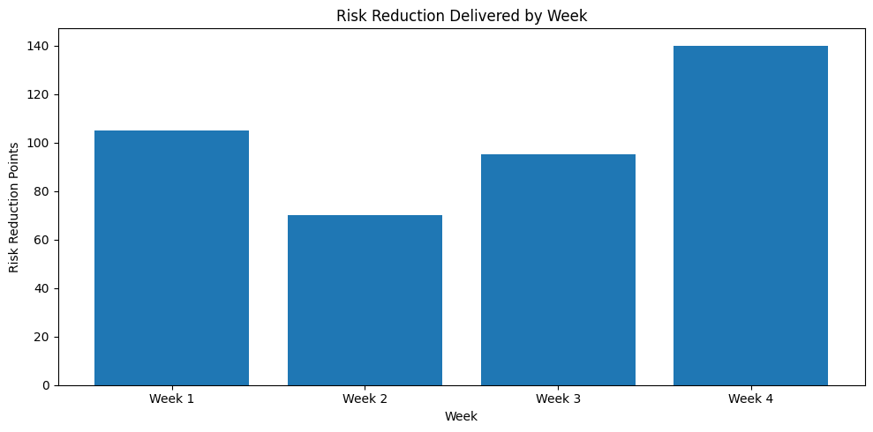
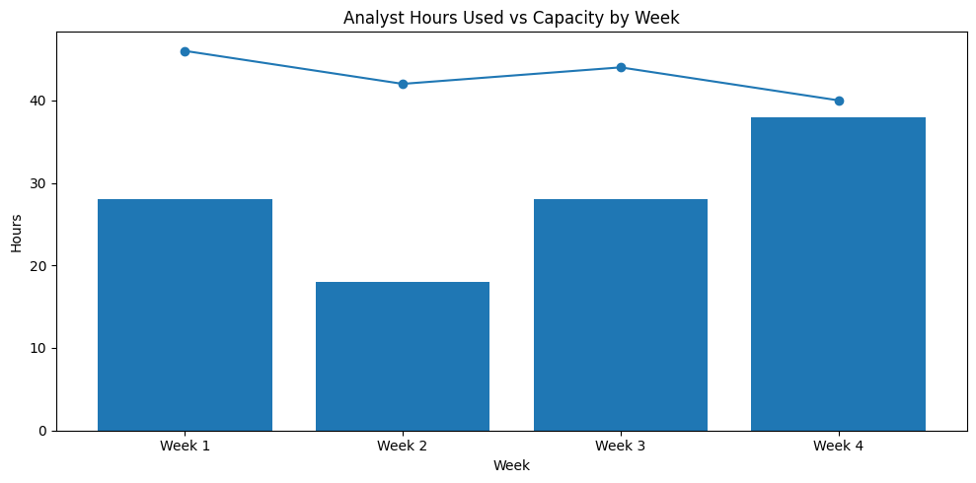
Risk Reduction by Week Based on Hours Capacity
A four-week remediation plan that prioritizes the highest-value security actions while staying within limits.
Scheduled fixes should be where risk reduction per unit is strongest and spread across the weeks, so the team does not overload maintenance windows.

Slide 5
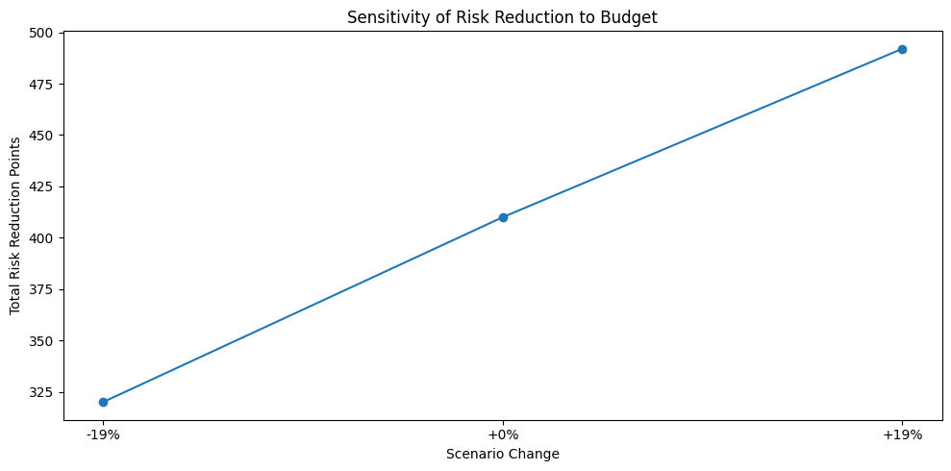
Sensitivity findings are robust within a range, but not equally sensitive
Total remediation budget, Weekly analyst hours, Risk reduction estimates:
Reasonably robust when assumptions move within a certain range, but it is not equally sensitive to every parameter
When budget decreases, total risk reduction drops
At the base budget, the model gets a moderate risk reduction
When budget increases, risk reduction improves significantly

Slide 6
Over-time efficiency based on a four-week program
The four-week structure creates a practical rollout schedule rather than a generic priority list.
Leadership doesn’t approve risk reduction, they approve work that must be staffed, scheduled, and coordinated with operations.
Time is a real part of this cybersecurity problem because remediation is not a one-time thing.
It must be performed over multiple days or weeks.
It must decide when to perform each fix, so the team does not exceed analyst hours or interrupt business systems all at once.

Slide 7
Limitations of the model-with real world reflections
Model assumes risk reduction is linear, but real security gains often have diminishing returns.
Treats vulnerabilities as independent, but real attacks can chain multiple weaknesses.
Assumes fixed labor and downtime, while capacity can shift week to week.
Uses estimated risk scores, which may not reflect real exploit likelihood.
Produces a feasible plan, but execution risk (delays, outages) is not modeled.

Slide 8
Final Iteration output and recommendation
DO NOT blindly follow the model, always make sure to have human checkpoints.
Execute the four-week remediation plan produced by the model, beginning with the highest-value critical assets.
This plan delivers the strongest risk reduction without exceeding labor, downtime, or budget limits.
The organization should validate two assumptions:
First, that the estimated risk reduction values are directionally correct.
Second, that the required analyst hours are realistic given other security work.
The first step should be to confirm the Week 1 and Week 2 maintenance windows with owners, then lock the initial remediation schedule and review capacity again at the end of each week.

